Slide 1
Multiple SWT Display instances support using GTK
Initiative-31

Slide 2
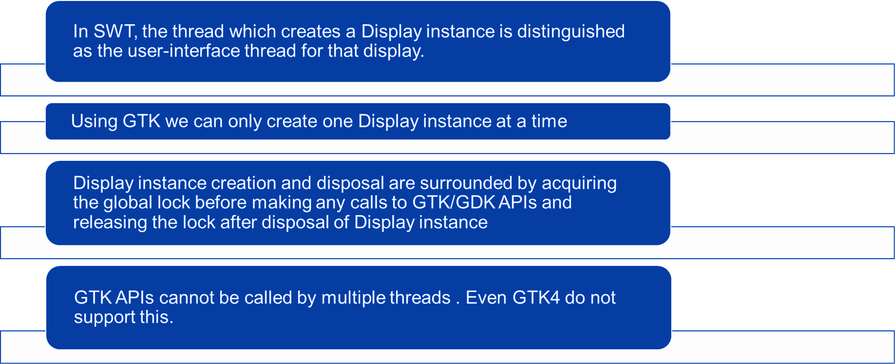
Overview
SWT UI Thread (using GTK)

Slide 3
Access GTK APIs from multiple threads
Snippet 1
Display display = new Display ();
.
.
display.dispose ();
UI Thread / Display
int main (int argc, char *argv[])
{
GtkWidget *window;
g_thread_init (NULL);
//SWT’s createDisplay() and register() methods
gdk_threads_init ();
gdk_threads_enter ();
gtk_init (&argc, &argv);
window = create_window ();
gtk_widget_show (window);
gtk_main ();
//SWT’s destroy() and destroyDisplay() method
gdk_threads_leave ();
return 0;
}
Thread 1
Thread 1 initialized GTK and started main loop and only thread 1 can use GTK APIs
Can’t use GTK APIs from multiple Threads
Snippet 2
Display display = new Display ();
.
.
display.dispose ();
GTK
Thread 2
Thread 2 tries to initialize GTK when thread 1 is still running and fails to acquire GTK lock.

Slide 4
How it works in windows and not in Linux
SWT in Windows
SWT
SWT in Linux
SWT
Allows creation of multiple Display instances (Multiple UI threads)
Init() method in Display.java
win32
Supports sharing the objects like GDIP between the threads
Not recommended unless proper synchronization is available.
Windows
Reference
GetCurrentThreadId() – win32 API
SWT
Does not allow creation of multiple Display instances (Multiple UI threads)
createDisplay() method in Display.java
GTK
GTK's design philosophy is based on a single UI thread to manage the application's event loop and UI updates
GTK is thread aware but not thread safe
Linux
Reference on GTK’s design based on single UI thread.
'gdk_threads_enter()' and 'gdk_threads_leave()’
Reference on GDK is not thread safe.

Slide 5
Thank you!

